Slide 1
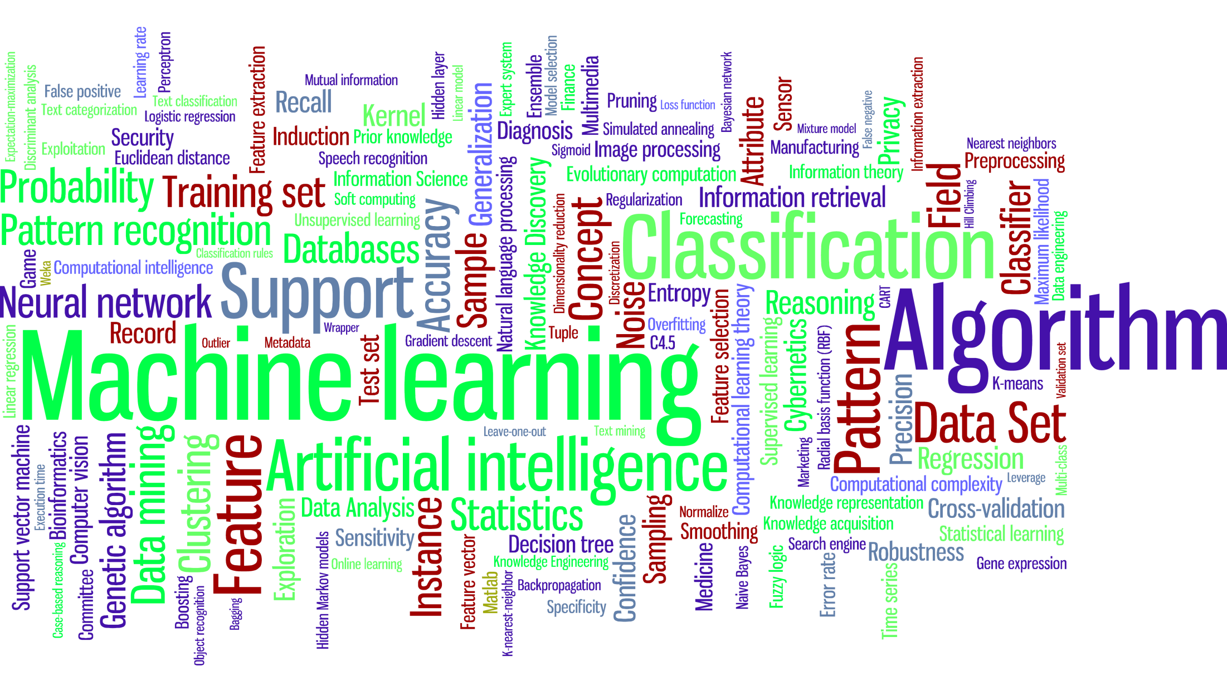
Introduction to Machine Learning
Lior Rokach
Department of Information Systems Engineering
Ben-Gurion University of the Negev

Slide 2





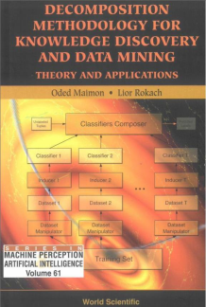




About Me
Prof. Lior Rokach
Department of Information Systems Engineering
Faculty of Engineering Sciences
Head of the Machine Learning Lab
Ben-Gurion University of the Negev
Email: liorrk@bgu.ac.il
http://www.ise.bgu.ac.il/faculty/liorr/
PhD (2004) from Tel Aviv University

Slide 3
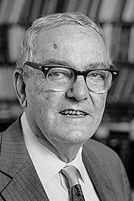
Machine Learning
Herbert Alexander Simon: “Learning is any process by which a system improves performance from experience.”
“Machine Learning is concerned with computer programs that automatically improve their performance through experience. “
Herbert Simon
Turing Award 1975 Nobel Prize in Economics 1978

Slide 4
Why Machine Learning?
Develop systems that can automatically adapt and customize themselves to individual users.
Personalized news or mail filter
Discover new knowledge from large databases (data mining).
Market basket analysis (e.g. diapers and beer)
Ability to mimic human and replace certain monotonous tasks - which require some intelligence.
like recognizing handwritten characters
Develop systems that are too difficult/expensive to construct manually because they require specific detailed skills or knowledge tuned to a specific task (knowledge engineering bottleneck).

Slide 5
Why now?
Flood of available data (especially with the advent of the Internet)
Increasing computational power
Growing progress in available algorithms and theory developed by researchers
Increasing support from industries

Slide 6
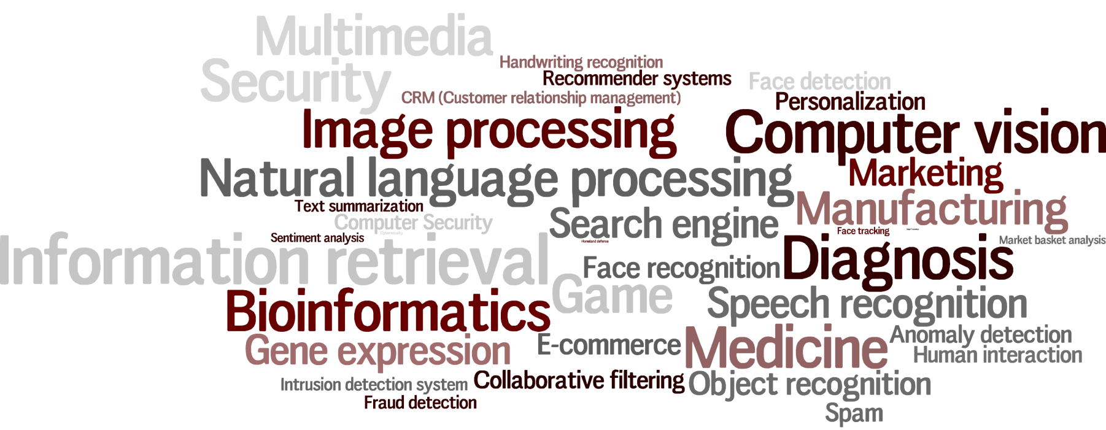
ML Applications

Slide 7
The concept of learning in a ML system
Learning = Improving with experience at some task
Improve over task T,
With respect to performance measure, P
Based on experience, E.

Slide 8
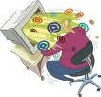
Motivating Example Learning to Filter Spam
Example: Spam Filtering
Spam - is all email the user does not want to receive and has not asked to receive
T: Identify Spam Emails
P:
% of spam emails that were filtered
% of ham/ (non-spam) emails that were incorrectly filtered-out
E: a database of emails that were labelled by users

Slide 9
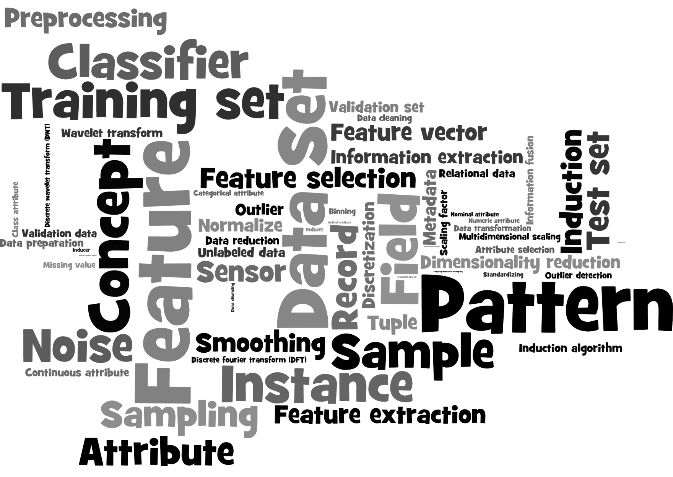
The Learning Process

Slide 10
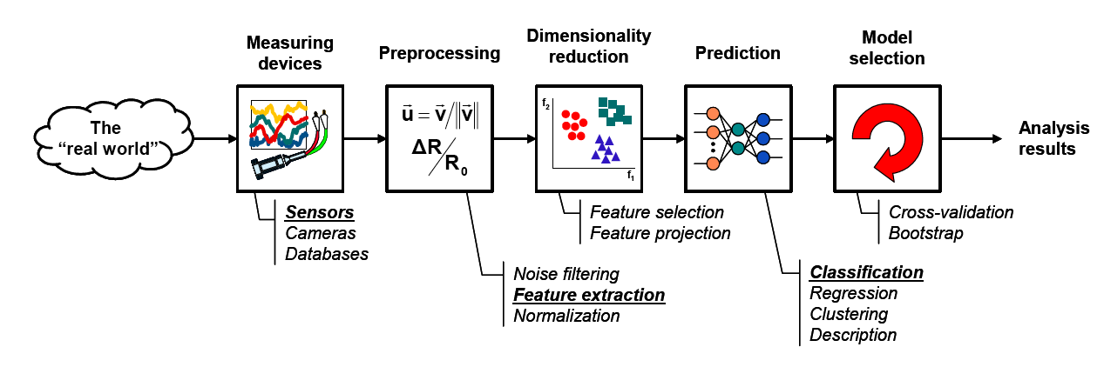
The Learning Process
Model Learning
Model Testing

Slide 11

The Learning Process in our Example
Model Learning
Model Testing
● Number of recipients
● Size of message
● Number of attachments
● Number of "re's" in the subject line
…
Email Server

Slide 12

Data Set
Target Attribute
Input Attributes
Email Type | Customer Type | Country (IP) | Email Length (K) | Number of new Recipients
Ham | Gold | Germany | 2 | 0
Ham | Silver | Germany | 4 | 1
Spam | Bronze | Nigeria | 2 | 5
Spam | Bronze | Russia | 4 | 2
Ham | Bronze | Germany | 4 | 3
Ham | Silver | USA | 1 | 0
Spam | Silver | USA | 2 | 4
Instances
Numeric
Nominal
Ordinal

Slide 13

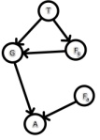
Step 4: Model Learning
Learner
Inducer
Induction Algorithm
Classifier
Classification Model
Database
Training Set

Slide 14




Step 5: Model Testing
Database
Training Set
Learner
Inducer
Induction Algorithm
Classifier
Classification Model

Slide 15
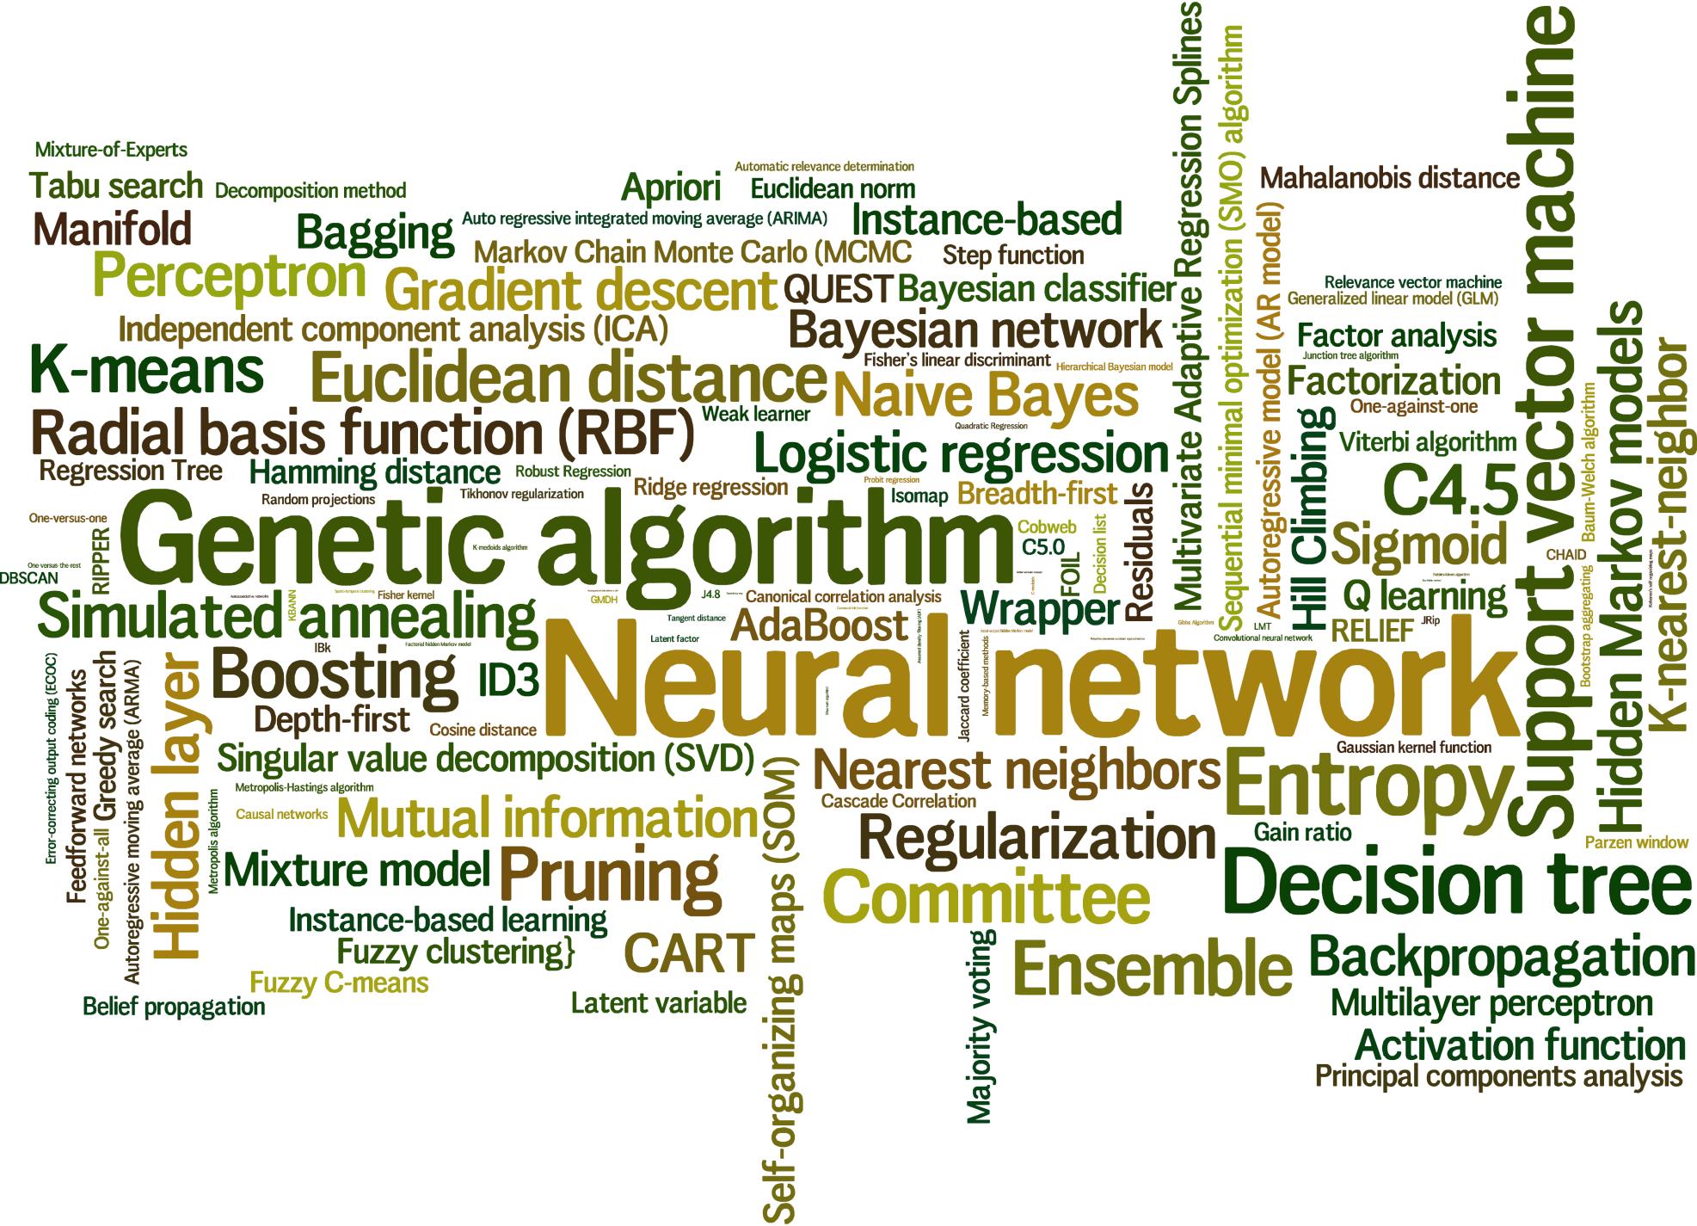
Learning Algorithms

Slide 16
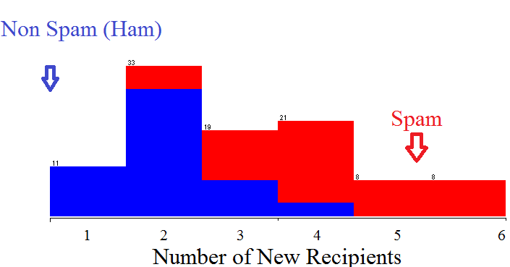

Slide 18
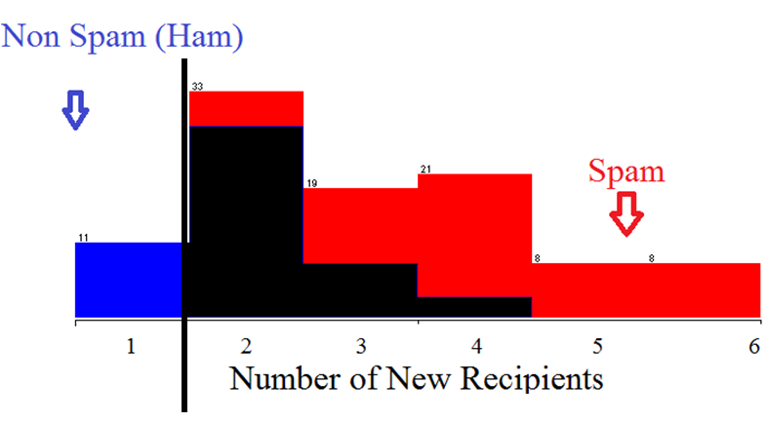
Error

Slide 20
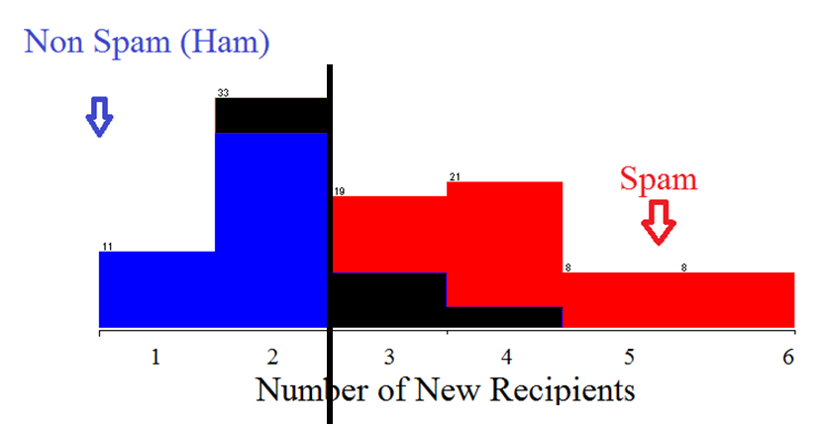

Slide 21
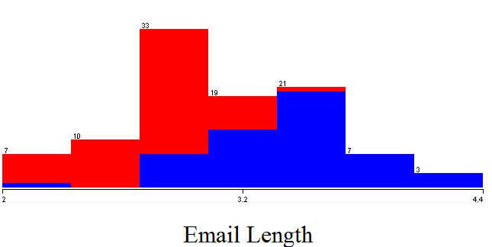

Slide 22
Linear Classifiers
How would you classify this data?
Email Length
New Recipients

Slide 23
Linear Classifiers
How would you classify this data?
Email Length
New Recipients

Slide 24
When a new email is sent
We first place the new email in the space
Classify it according to the subspace in which it resides
Email Length
New Recipients

Slide 25
Linear Classifiers
How would you classify this data?
Email Length
New Recipients

Slide 26
Linear Classifiers
How would you classify this data?
Email Length
New Recipients

Slide 27
Linear Classifiers
How would you classify this data?
Email Length
New Recipients

Slide 28
Linear Classifiers
Any of these would be fine..
..but which is best?
Email Length
New Recipients

Slide 29
Classifier Margin
Define the margin of a linear classifier as the width that the boundary could be increased by before hitting a datapoint.
Email Length
New Recipients

Slide 30
Maximum Margin
The maximum margin linear classifier is the linear classifier with the, maximum margin.
This is the simplest kind of SVM (Called an LSVM)
Email Length
New Recipients
Linear SVM

Slide 31
No Linear Classifier can cover all instances
How would you classify this data?
Email Length
New Recipients

Slide 32
Ideally, the best decision boundary should be the one which provides an optimal performance such as in the following figure

Slide 33
No Linear Classifier can cover all instances
Email Length
New Recipients

Slide 34
However, our satisfaction is premature because the central aim of designing a classifier is to correctly classify novel input
Issue of generalization!

Slide 35
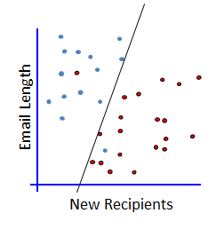
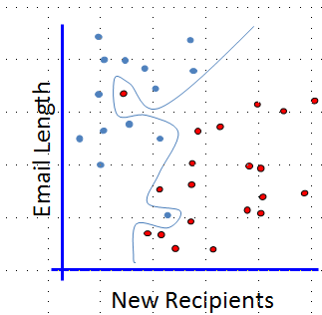
Which one?
2 Errors
Simple model
0 Errors
Complicated model

Slide 36
Evaluating What’s Been Learned
We randomly select a portion of the data to be used for training (the training set)
Train the model on the training set.
Once the model is trained, we run the model on the remaining instances (the test set) to see how it performs
Confusion Matrix
Classified As
Red | Blue
1 | 7 | Blue
5 | 0 | Red
Email Length
Actual
New Recipients

Slide 37
The Non-linearly separable case
Email Length
New Recipients

Slide 38
The Non-linearly separable case
Email Length
New Recipients

Slide 39
The Non-linearly separable case
Email Length
New Recipients

Slide 40
The Non-linearly separable case
Email Length
New Recipients

Slide 41
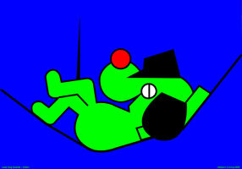

Lazy Learners
Generalization beyond the training data is delayed until a new instance is provided to the system
I’m Lazy
Training Set
Learner
Classifier

Slide 42

Lazy Learners Instance-based learning
Training Set

Slide 43
Lazy Learner: k-Nearest Neighbors
What should be k?
Which distance measure should be used?
K=3
Email Length
New Recipients

Slide 44
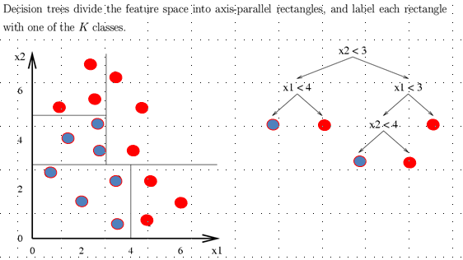
Decision tree
A flow-chart-like tree structure
Internal node denotes a test on an attribute
Branch represents an outcome of the test
Leaf nodes represent class labels or class distribution

Slide 45
Top Down Induction of Decision Trees
Email Len
<1.8
≥1.8
Spam
Ham
Email Length
1 Error
8 Errors
New Recipients
A single level decision tree is also known as Decision Stump

Slide 46
Top Down Induction of Decision Trees
Email Len
<1.8
≥1.8
Spam
Ham
Email Length
1 Error
8 Errors
New Recip
New Recipients
<2.3
≥2.3
Spam
Ham
4 Errors
11 Errors

Slide 47
Top Down Induction of Decision Trees
Email Len
<1.8
≥1.8
Spam
Ham
Email Length
1 Error
8 Errors
New Recip
New Recipients
<2.3
≥2.3
Spam
Ham
4 Errors
11 Errors

Slide 48
Top Down Induction of Decision Trees
Email Len
<1.8
≥1.8
Spam
Email Len
Email Length
1 Error
<4
≥4
Ham
Spam
New Recipients
3 Errors
1 Error

Slide 49
Top Down Induction of Decision Trees
Email Len
<1.8
≥1.8
Spam
Email Len
Email Length
1 Error
<4
≥4
Spam
New Recip
New Recipients
1 Error
<1
≥1
Spam
Ham
0 Errors
1 Error

Slide 50
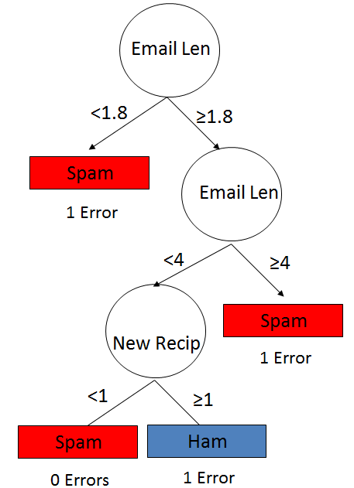
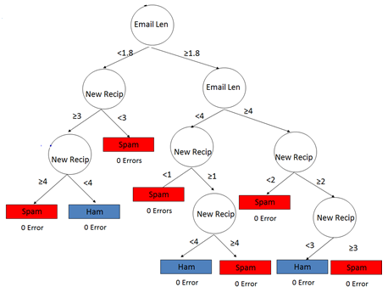
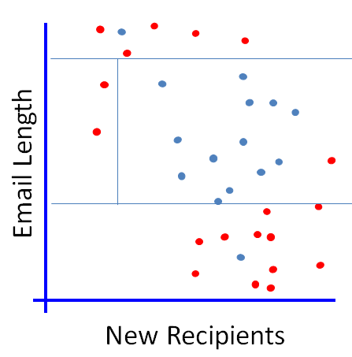
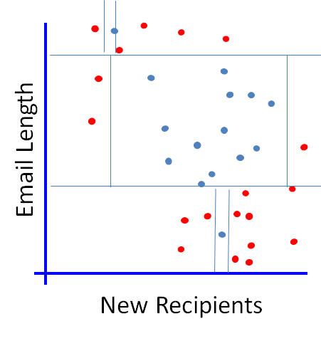
Which One?

Slide 51
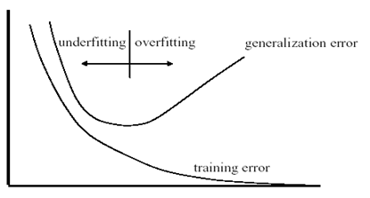
Overfitting and underfitting
Error
Tree Size
Overtraining: means that it learns the training set too well – it overfits to the training set such that it performs poorly on the test set.
Underfitting: when model is too simple, both training and test errors are large

Slide 52
Neural Network Model
Inputs
Output
Age
34
.6
.4
.2
Σ
0.6
.1
.5
Gender
2
Σ
.3
.2
.8
.7
Σ
“Probability of beingAlive”
Stage
4
.2
Dependent variable
Prediction
Independent variables
Weights
HiddenLayer
Weights

Slide 53
“Combined logistic models”
Inputs
Output
Age
34
.6
.5
0.6
.1
Gender
2
Σ
.7
.8
“Probability of beingAlive”
Stage
4
Dependent variable
Prediction
Independent variables
Weights
HiddenLayer
Weights

Slide 54
Inputs
Output
Age
34
.2
.5
0.6
Gender
2
Σ
.3
.8
“Probability of beingAlive”
Stage
4
.2
Dependent variable
Prediction
Independent variables
Weights
HiddenLayer
Weights

Slide 55
Inputs
Output
Age
34
.6
.2
.5
0.6
.1
Gender
1
Σ
.3
.7
.8
“Probability of beingAlive”
Stage
4
.2
Dependent variable
Prediction
Independent variables
Weights
HiddenLayer
Weights

Slide 56
Age
34
.6
.4
.2
Σ
0.6
.1
.5
Gender
2
Σ
.3
.2
.8
.7
Σ
“Probability of beingAlive”
Stage
4
.2
Dependent variable
Prediction
Independent variables
Weights
HiddenLayer
Weights

Slide 57
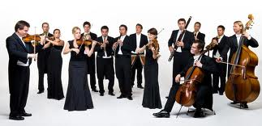
Ensemble Learning
The idea is to use multiple models to obtain better predictive performance than could be obtained from any of the constituent models.
Boosting involves incrementally building an ensemble by training each new model instance to emphasize the training instances that previous models misclassified.

Slide 58
Example of Ensemble of Weak Classifiers
Training
Combined classifier

Slide 59
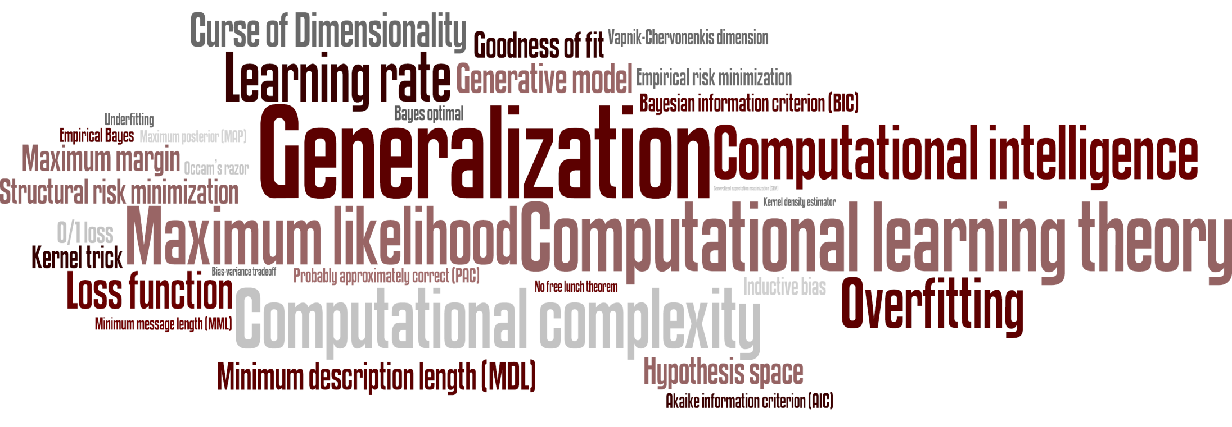
Main Principles

Slide 60
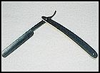

Occam's razor (14th-century)
In Latin “lex parsimoniae”, translating to “law of parsimony”
The explanation of any phenomenon should make as few assumptions as possible, eliminating those that make no difference in the observable predictions of the explanatory hypothesis or theory
The Occam Dilemma: Unfortunately, in ML, accuracy and simplicity (interpretability) are in conflict.

Slide 61

No Free Lunch Theorem in Machine Learning (Wolpert, 2001)
“For any two learning algorithms, there are just as many situations (appropriately weighted) in which algorithm one is superior to algorithm two as vice versa, according to any of the measures of "superiority"

Slide 62
So why developing new algorithms?
Practitioner are mostly concerned with choosing the most appropriate algorithm for the problem at hand
This requires some a priori knowledge – data distribution, prior probabilities, complexity of the problem, the physics of the underlying phenomenon, etc.
The No Free Lunch theorem tells us that – unless we have some a priori knowledge – simple classifiers (or complex ones for that matter) are not necessarily better than others. However, given some a priori information, certain classifiers may better MATCH the characteristics of certain type of problems.
The main challenge of the practitioner is then, to identify the correct match between the problem and the classifier! …which is yet another reason to arm yourself with a diverse set of learner arsenal !

Slide 63
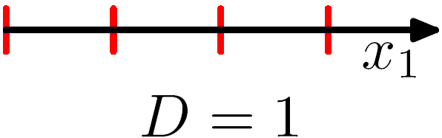
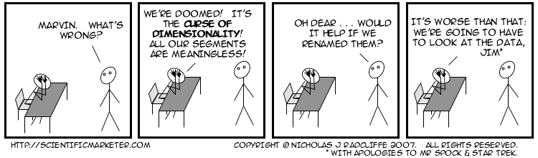
Less is More? The Curse of Dimensionality (Bellman, 1961)

Slide 64
Less is More? The Curse of Dimensionality
Learning from a high-dimensional feature space requires an enormous amount of training to ensure that there are several samples with each combination of values.
With a fixed number of training instances, the predictive power reduces as the dimensionality increases.
As a counter-measure, many dimensionality reduction techniques have been proposed, and it has been shown that when done properly, the properties or structures of the objects can be well preserved even in the lower dimensions.
Nevertheless, naively applying dimensionality reduction can lead to pathological results.

Slide 65
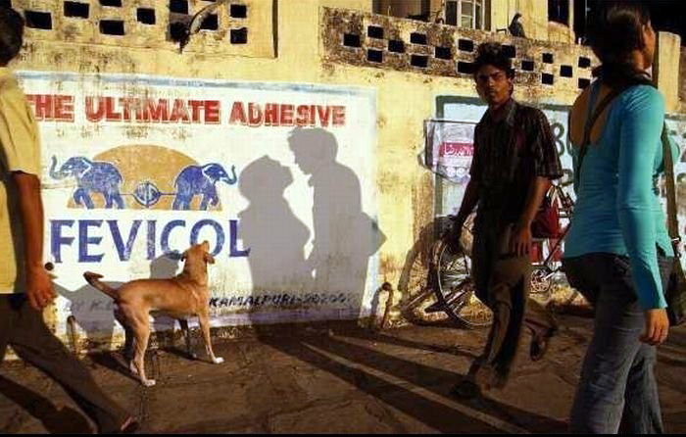
While dimensionality reduction is an important tool in machine learning/data mining, we must always be aware that it can distort the data in misleading ways.
Above is a two dimensional projection of an intrinsically three dimensional world….

Slide 66
Original photographer unknown
See also www.cs.gmu.edu/~jessica/DimReducDanger.htm (c) eamonn keogh

Slide 67
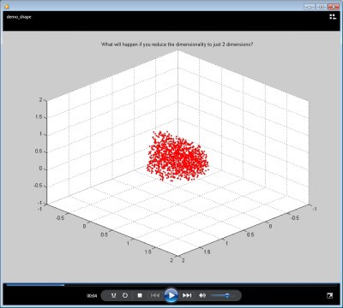
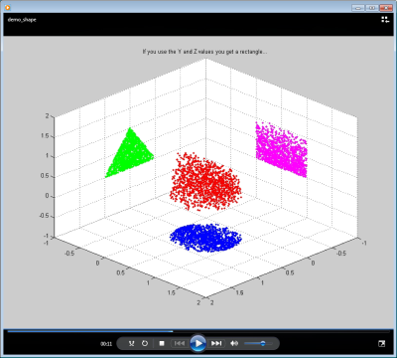
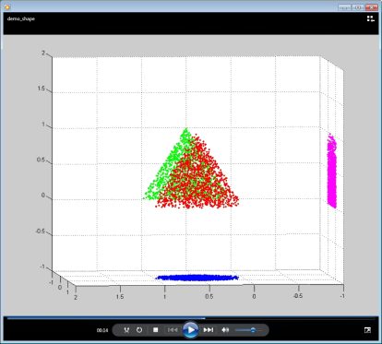
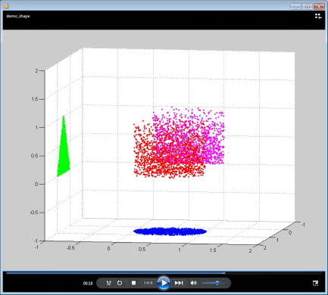
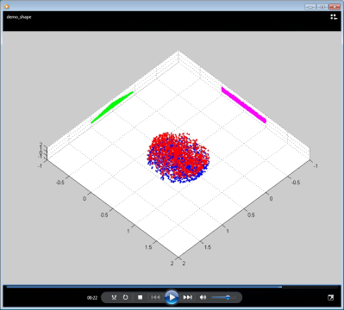
Screen dumps of a short video from www.cs.gmu.edu/~jessica/DimReducDanger.htm
I recommend you imbed the original video instead
A cloud of points in 3D
Can be projected into 2D
XY or XZ or YZ
In 2D XZ we see a triangle
In 2D YZ we see a square
In 2D XY we see a circle

Slide 68
Less is More?
In the past the published advice was that high dimensionality is dangerous.
But, Reducing dimensionality reduces the amount of information available for prediction.
Today: try going in the opposite direction: Instead of reducing dimensionality, increase it by adding many functions of the predictor variables.
The higher the dimensionality of the set of features, the more likely it is that separation occurs.

Slide 69
Meaningfulness of Answers
A big data-mining risk is that you will “discover” patterns that are meaningless.
Statisticians call it Bonferroni’s principle: (roughly) if you look in more places for interesting patterns than your amount of data will support, you are bound to find crap.

Slide 70
Examples of Bonferroni’s Principle
Track Terrorists
The Rhine Paradox: a great example of how not to conduct scientific research.

Slide 71
Why Tracking Terrorists Is (Almost) Impossible!
Suppose we believe that certain groups of evil-doers are meeting occasionally in hotels to plot doing evil.
We want to find (unrelated) people who at least twice have stayed at the same hotel on the same day.

Slide 72
The Details
10⁹ people being tracked.
1000 days.
Each person stays in a hotel 1% of the time (10 days out of 1000).
Hotels hold 100 people (so 10⁵ hotels).
If everyone behaves randomly (I.e., no evil-doers) will the data mining detect anything suspicious?

Slide 73
Calculations – (1)
q at
some
hotel
p at
some
hotel
Same
hotel
Probability that given persons p and q will be at the same hotel on given day d :
1/100 × 1/100 × 10⁻⁵ = 10⁻⁹.
Probability that p and q will be at the same hotel on given days d₁ and d₂:
10⁻⁹ × 10⁻⁹ = 10⁻¹⁸.
Pairs of days:
5×10⁵.

Slide 74
Calculations – (2)
Probability that p and q will be at the same hotel on some two days:
5×10⁵ × 10⁻¹⁸ = 5×10⁻¹³.
Pairs of people:
5×10¹⁷.
Expected number of “suspicious” pairs of people:
5×10¹⁷ × 5×10⁻¹³ = 250,000.

Slide 75
Conclusion
Suppose there are (say) 10 pairs of evil-doers who definitely stayed at the same hotel twice.
Analysts have to sift through 250,010 candidates to find the 10 real cases.
Not gonna happen.
But how can we improve the scheme?

Slide 76
Moral
When looking for a property (e.g., “two people stayed at the same hotel twice”), make sure that the property does not allow so many possibilities that random data will surely produce facts “of interest.”

Slide 77
Rhine Paradox – (1)
Joseph Rhine was a parapsychologist in the 1950’s who hypothesized that some people had Extra-Sensory Perception.
He devised (something like) an experiment where subjects were asked to guess 10 hidden cards – red or blue.
He discovered that almost 1 in 1000 had ESP – they were able to get all 10 right!

Slide 78
Rhine Paradox – (2)
He told these people they had ESP and called them in for another test of the same type.
Alas, he discovered that almost all of them had lost their ESP.
What did he conclude?
Answer on next slide.

Slide 79
Rhine Paradox – (3)
He concluded that you shouldn’t tell people they have ESP; it causes them to lose it.

Slide 80
Moral
Understanding Bonferroni’s Principle will help you look a little less stupid than a parapsychologist.

Slide 81
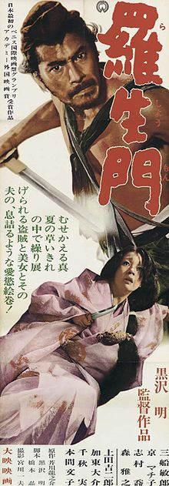
Instability and the Rashomon Effect
Rashomon is a Japanese movie in which four people, from different vantage points, witness a criminal incident. When they come to testify in court, they all report the same facts, but their stories of what happened are very different.
The Rashomon effect is the effect of the subjectivity of perception on recollection.
The Rashomon Effect in ML is that there is often a multitude of classifiers of giving about the same minimum error rate.
For example in decition trees, if the training set is perturbed only slightly, I can get a tree quite different from the original but with almost the same test set error.

Slide 82

The Wisdom of Crowds Why the Many Are Smarter Than the Few and How Collective Wisdom Shapes Business, Economies, Societies and Nations
Under certain controlled conditions, the aggregation of information in groups, resulting in decisions that are often superior to those that can been made by any single - even experts.
Imitates our second nature to seek several opinions before making any crucial decision. We weigh the individual opinions, and combine them to reach a final decision

Slide 83
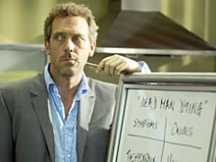
Committees of Experts
“ … a medical school that has the objective that all students, given a problem, come up with an identical solution”
There is not much point in setting up a committee of experts from such a group - such a committee will not improve on the judgment of an individual.
Consider:
There needs to be disagreement for the committee to have the potential to be better than an individual.

Slide 84
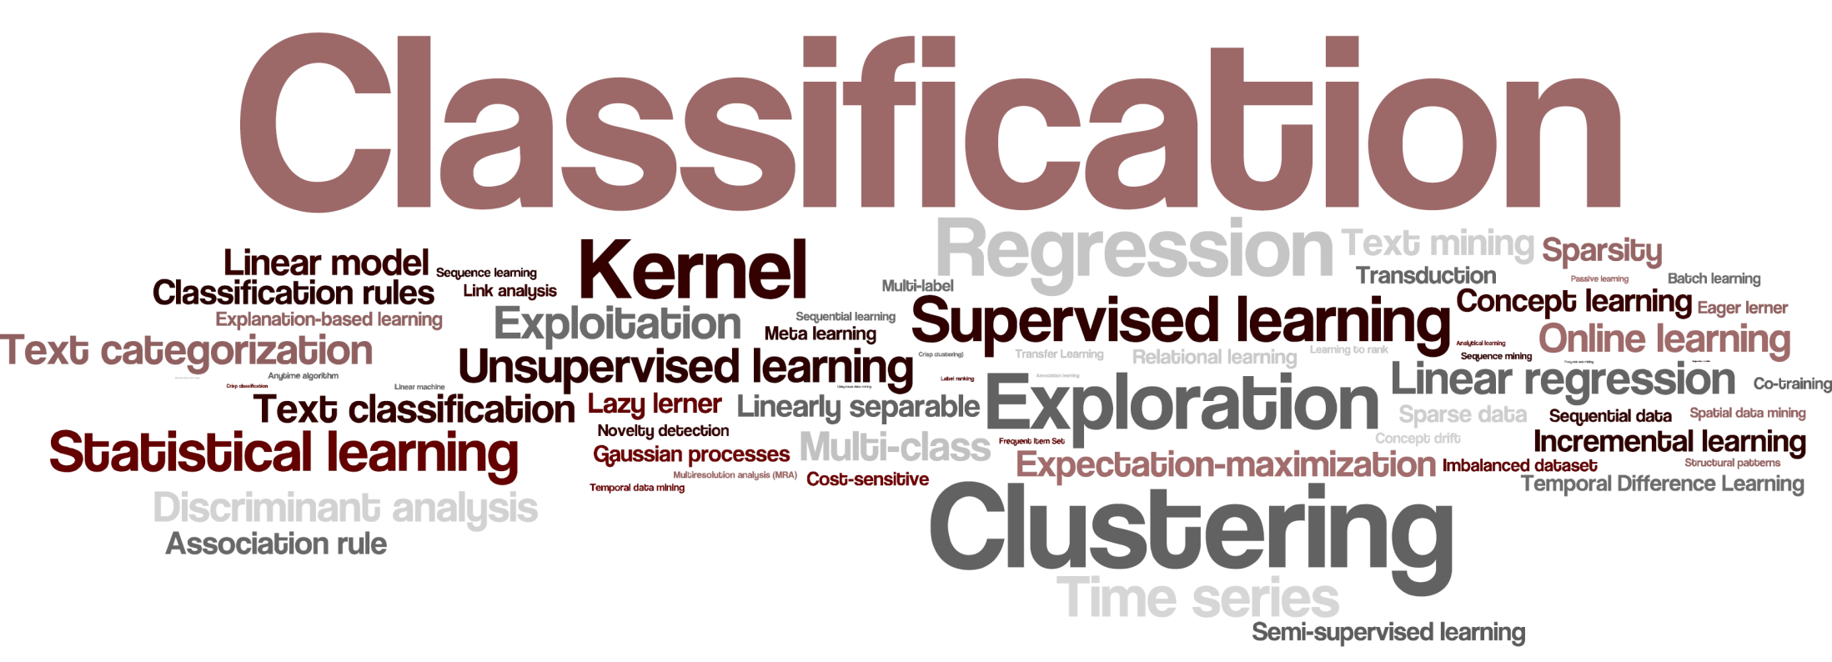
Other Learning Tasks

Slide 85
Supervised Learning - Multi Class
Email Length
New Recipients

Slide 86
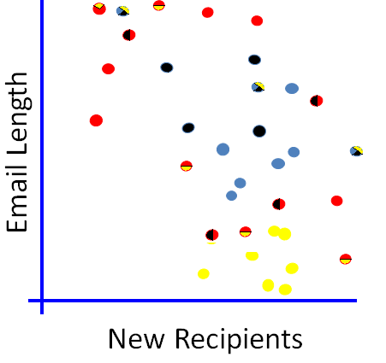
Supervised Learning - Multi Label
Multi-label learning refers to the classification problem where each example can be assigned to multiple class labels simultaneously

Slide 87
Supervised Learning - Regression
Find a relationship between a numeric dependent variable and one or more independent variables
Email Length
New Recipients

Slide 88
Unsupervised Learning - Clustering
Clustering is the assignment of a set of observations into subsets (called clusters) so that observations in the same cluster are similar in some sense
Email Length
New Recipients

Slide 89
Unsupervised Learning–Anomaly Detection
Detecting patterns in a given data set that do not conform to an established normal behavior.
Email Length
New Recipients

Slide 90
Source of Training Data
Provided random examples outside of the learner’s control.
Passive Learning
Negative examples available or only positive? Semi-Supervised Learning
Imbalanced
Good training examples selected by a “benevolent teacher.”
“Near miss” examples
Learner can query an oracle about class of an unlabeled example in the environment.
Active Learning
Learner can construct an arbitrary example and query an oracle for its label.
Learner can run directly in the environment without any human guidance and obtain feedback.
Reinforcement Learning
There is no existing class concept
A form of discovery
Unsupervised Learning
Clustering
Association Rules

Slide 91
Other Learning Tasks
Other Supervised Learning Settings
Multi-Class Classification
Multi-Label Classification
Semi-supervised classification – make use of labeled and unlabeled data
One Class Classification – only instances from one label are given
Ranking and Preference Learning
Sequence labeling
Cost-sensitive Learning
Online learning and Incremental Learning- Learns one instance at a time.
Concept Drift
Multi-Task and Transfer Learning
Collective classification – When instances are dependent!

Slide 92

Software

Slide 93
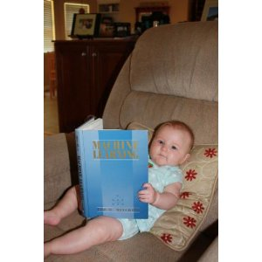
Want to Learn More?

Slide 94
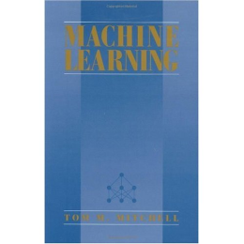
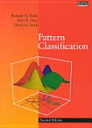


Want to Learn More?
Thomas Mitchell (1997), Machine Learning, Mcgraw-Hill.
R. Duda, P. Hart, and D. Stork (2000), Pattern Classification, Second Edition.
Ian H. Witten, Eibe Frank, Mark A. Hall (2011), Data Mining: Practical Machine Learning Tools and Techniques, Third Edition, The Morgan Kaufmann
Oded Maimon, Lior Rokach (2010), Data Mining and Knowledge Discovery Handbook, Second Edition, Springer.

